Slide 1
Nectar Bacteria in Flowering Plants
BIS 15L Winter 2026
Group 1: Chueh-Ju Kuo, Chelsea Ha
Notes:
Chelsea
Nectar bacteria stimulate pollen germination and bursting to enhance microbial fitness
Link to article: https://www.sciencedirect.com/science/article/pii/S0960982221009714?via%3Dihub
Main findings: Nectar bacteria Acinetobacter induce pollen germination and bursting
Pollen germination and bursting increase protein in solution
Germinability of pollen benefits Acinetobacter, but not nectar yeast
Acinetobacter pollinis induced over 5× greater pollen germination and 20× greater pollen bursting than that of uninoculated pollen by 45 min.
When provided with germinable pollen, A. pollinis stimulates protein release and grows to nearly twice the density compared to growth with ungerminable pollen, indicating that stimulation of germination benefits bacterial fitness.
In contrast, a common nectar-inhabiting yeast (Metschnikowia)33 neither induced nor benefited from pollen germination.
We conclude that Acinetobacter both specifically causes and benefits from inducing pollen germination and bursting.
Further study of microbe-pollen interactions may inform many aspects of pollination ecology, including floral microbial ecology,34,35 pollinator nutrient acquisition from pollen,2,3,21,36 and cues of pollen germination for plant reproduction

Slide 2
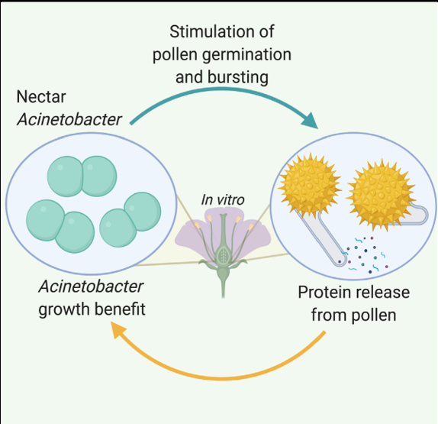
Notes:
https://phys.org/news/2025-02-scientists-toughest-biomaterials-clues-pollen.html
each pollen grain contains a tiny capsule, a cell that carries the male genetic material necessary for the next generation of plants.
When a pollen grain encounters a female plant of the same species, fertilization may happen and can give rise to a new generation. But immediate contact is not always a given. To survive harsh environments, pollen grain has developed a specific outer structure that protects the cell, allowing it to travel long distances with the wind or pollinators, such as insects, birds or reptiles.
"This tough outer wall is largely made of one of the most resistant biomaterials known on this planet. This makes the pollen grain wall highly resistant to environmental damage and some pollen grains can remain preserved in sedimentary rocks for millions of years," says Keech.
That a pollen grain can survive for such a long time span is thanks to an in-house energy production—the mitochondria. "It's a tiny compartment of the cell that is essential for its survival," says Keech.
https://www.ucdavis.edu/curiosity/news/common-floral-bacteria-can-induce-pollen-germination: “Despite the essential nutritional role of pollen for bees and other pollinators, we still know very little about how pollen is digested by anything,” Christensen said. “We found out that certain bacteria in flowers, Acinetobacter, can send a chemical signal to pollen that hijacks its systems and tells it to open the door from the inside — releasing protein and nutrients for the bacteria.”

Slide 3
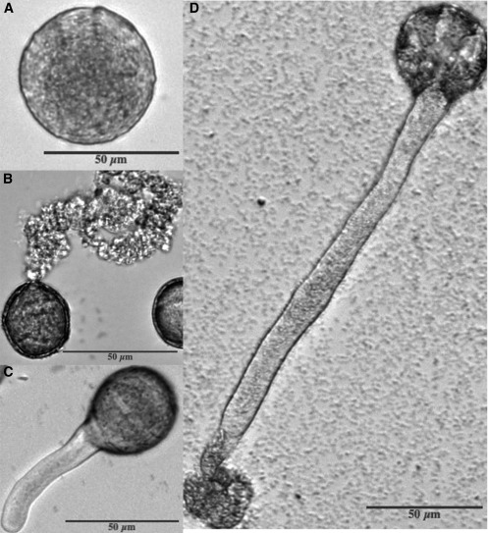

Slide 4
Discoveries
1
2
3
4
% of Pollen Germinated due to Microbial Bacteria
Bacterial Density and Pollen Germination
Pollen Conditions
Nutrient Release and Growth of Microbes
Notes:
What is the percentage of Pollen germinated with microbial species compared to a control variable (yeast)?
Pollen_microbe_data.csv (pollen_microbe)
germ_AN.csv (germination_burst)
Relationship between bacterial density and pollen germination
Dose_dependence-data.csv (dose_dependence)
Microbial growth with different pollen conditions (A.pollinis vs. Yeast (known not to induce germination process))
Apollinis_benefit_data (a_pollinis)
Yeast_benefit_data.csv (yeast_benefit)
Does pollen germination increase nutrient release?
Lowry_data1.csv (protein_density)
In a separate assay, we used a dilution series of SCC477 to determine whether concentration of SCC477 had an effect of pollen germination and bursting over 24 h. We found that bacterial effects on germination, bursting, and pollen tube length vary with bacterial titer. Pollen inoculated with the highest densities of SCC477 germinated and burst more quickly than those with lower bacterial densities (Figures S1A–S1C). Pollen tubes also grew to shorter lengths when inoculated with higher concentrations of SCC477 (Figure S1D).
The acinetobacter has the largest amount of germination at each timepoint, followed by the control, then the yeast. The control pectin degrader was used to rule out the idea that simply breaking open the pollen (by degrading pectin in the inner layer of the pollen grain) would result in germination; we can see that the control pectin degrader has very low germination, so we can rule out that idea. The acinetobacter treatment has the highest germination, which suggests that the acinetobacter is inducing germination.
"Evidence presented here—including minimal effects of Pectobacterium, a known pectinase producer, and a lack of detected pectinase activity by Acinetobacter—suggest that pectinases alone are not responsible for the germination or bursting phenotype."
We can see if the type of microbial group has any correlation with the number of germinated pollen (pollen tubes are fully grown), the number of grains that burst (pollen tubes are not fully grown and the pollen grain is broken), and the number of grains that burst at the tip.

Slide 5
Table of contents Cont.
5
6
Shiny App
Conclusion
Notes:
Density-dependence: To test whether pollen responds differently to differing amounts of Acinetobacter, we repeated the above methods, but inoculated pollen with dilution series of A. pollinis SCC477 suspensions (1, 1:2, 1:3, 1:5, 1:20, 1:100) as well as sterile BK (no microbes).

Slide 6
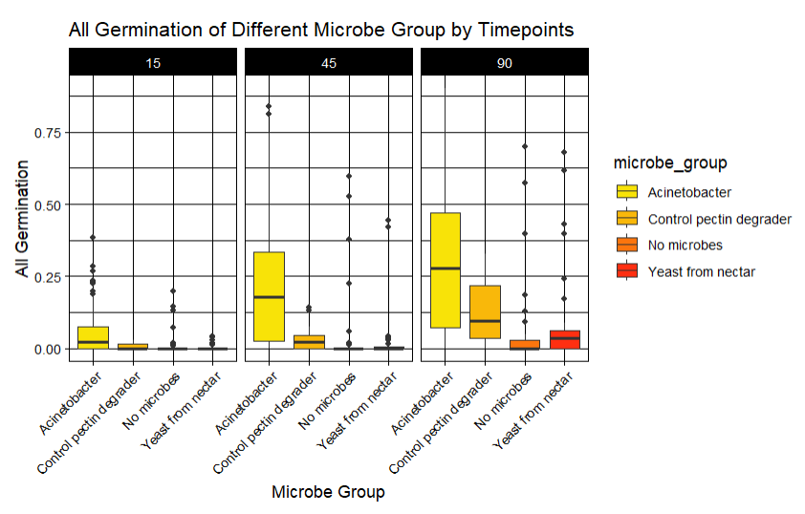
Notes:
Longer time → higher germination
Focus at Acinetobacter

Slide 7
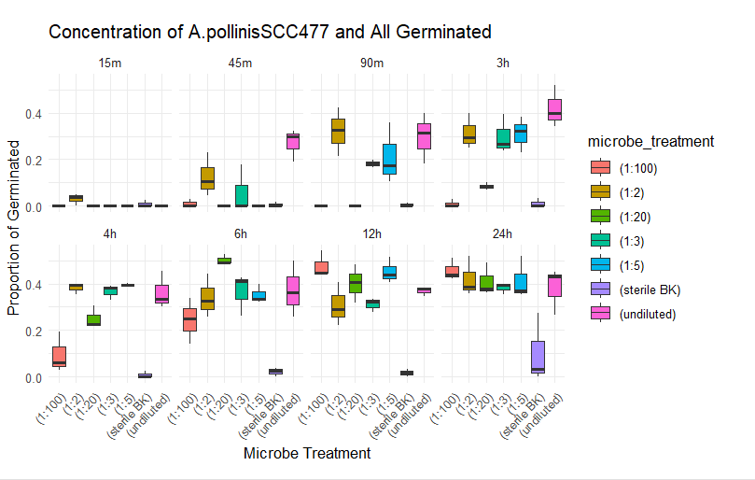
Notes:
- undiluted appears to maintained its position in proportion of germinated if using allgerm
(The proportion of pollen grains that germinated, including both “number.germ” and “number.tip.burst”)
-undiluted higher is higher first three hour → maybe many pollen quickly being burst
- might indicated higher concentration increase both bursting and germination
Across many timepoints, the higher-concentration treatments (especially undiluted, 1:2, and 1:3) generally show higher proportions of germinated pollen than the more diluted treatments such as 1:20 or 1:100.
This indicates that:
More bacteria → more pollen germination
The effect is dose-dependent.
From 15 minutes → 24 hours, the proportion of germinated pollen generally increases.
At 15 min, germination is very low for most treatments.
By 45–90 min, some higher concentrations begin showing noticeable germination.
From 3–24 hours, many treatments show much higher proportions of germinated pollen.
This suggests that the bacteria need time to interact with the pollen to trigger germination.
*Acinetobacter pollinis can stimulate pollen germination, allowing the bacteria to access nutrients inside pollen grains.

Slide 8
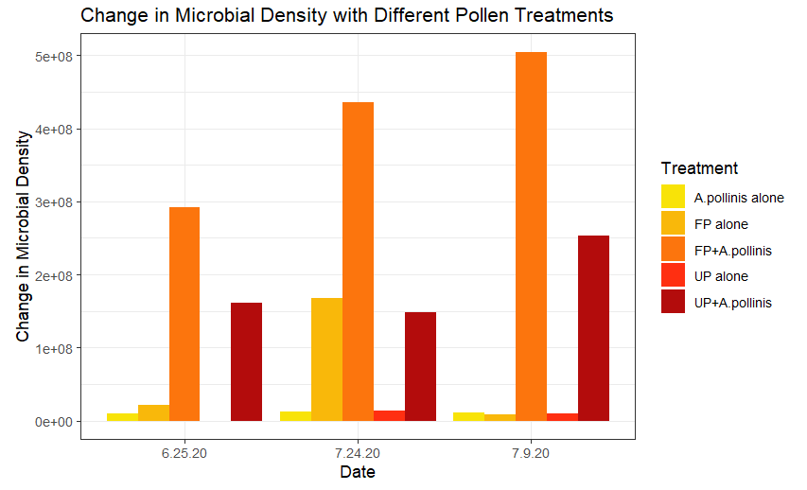

Slide 9
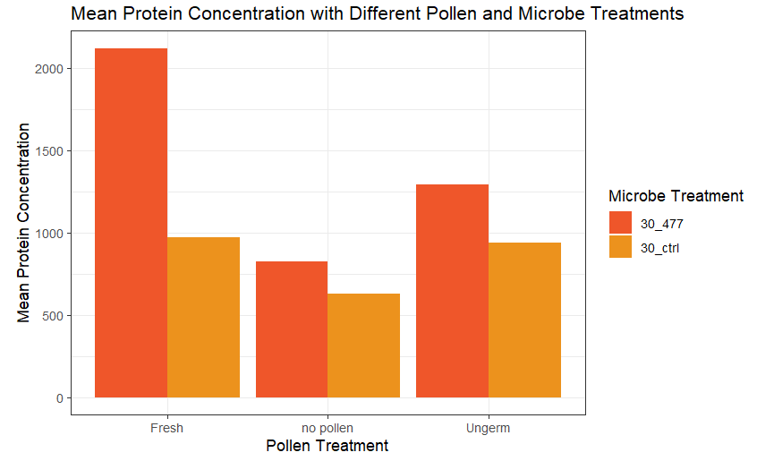

Slide 10
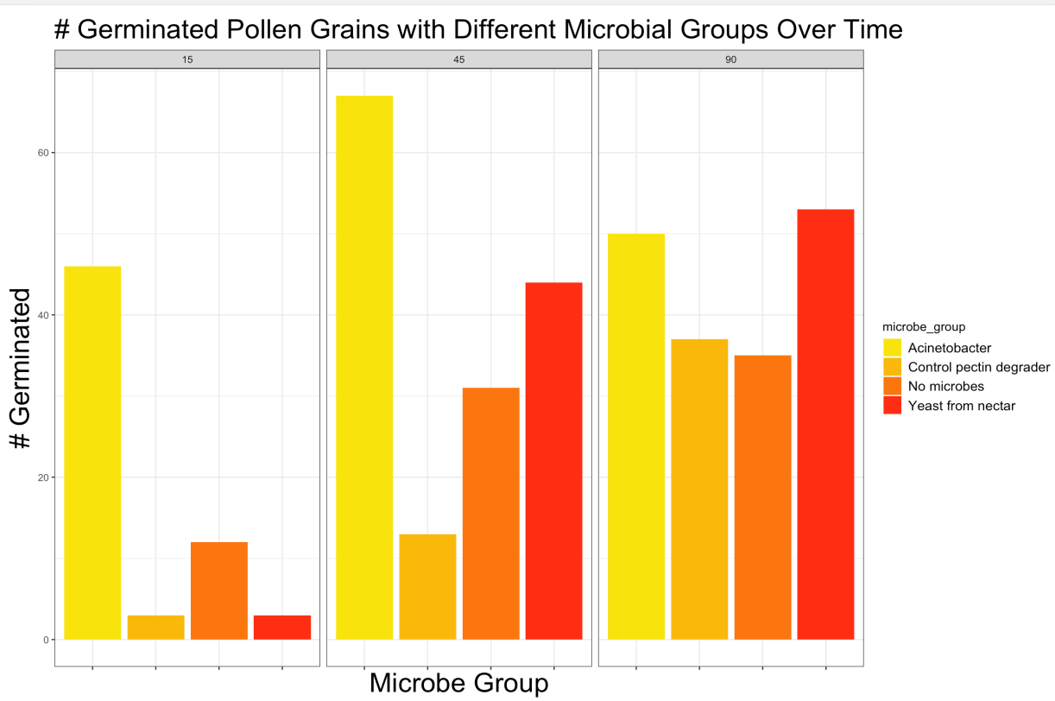

Slide 11
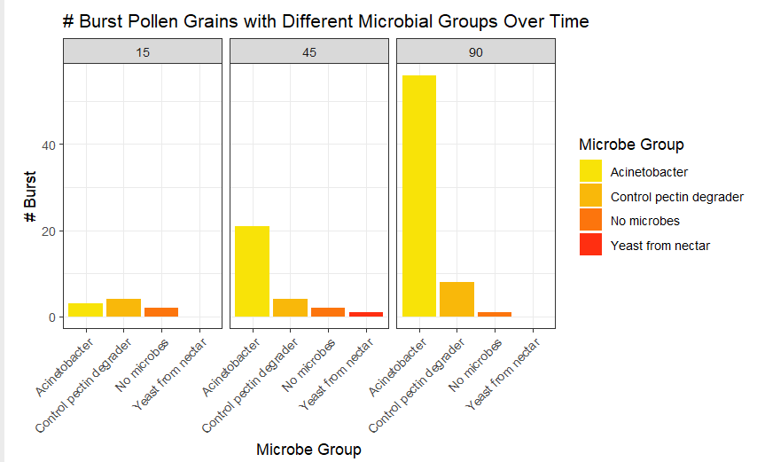

Slide 12
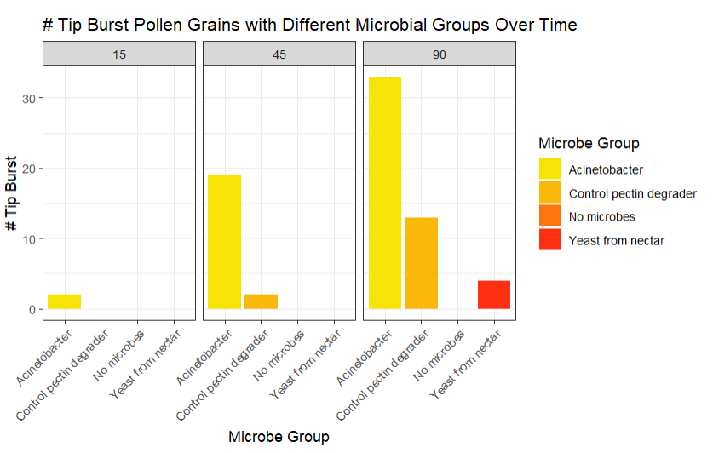

Slide 13
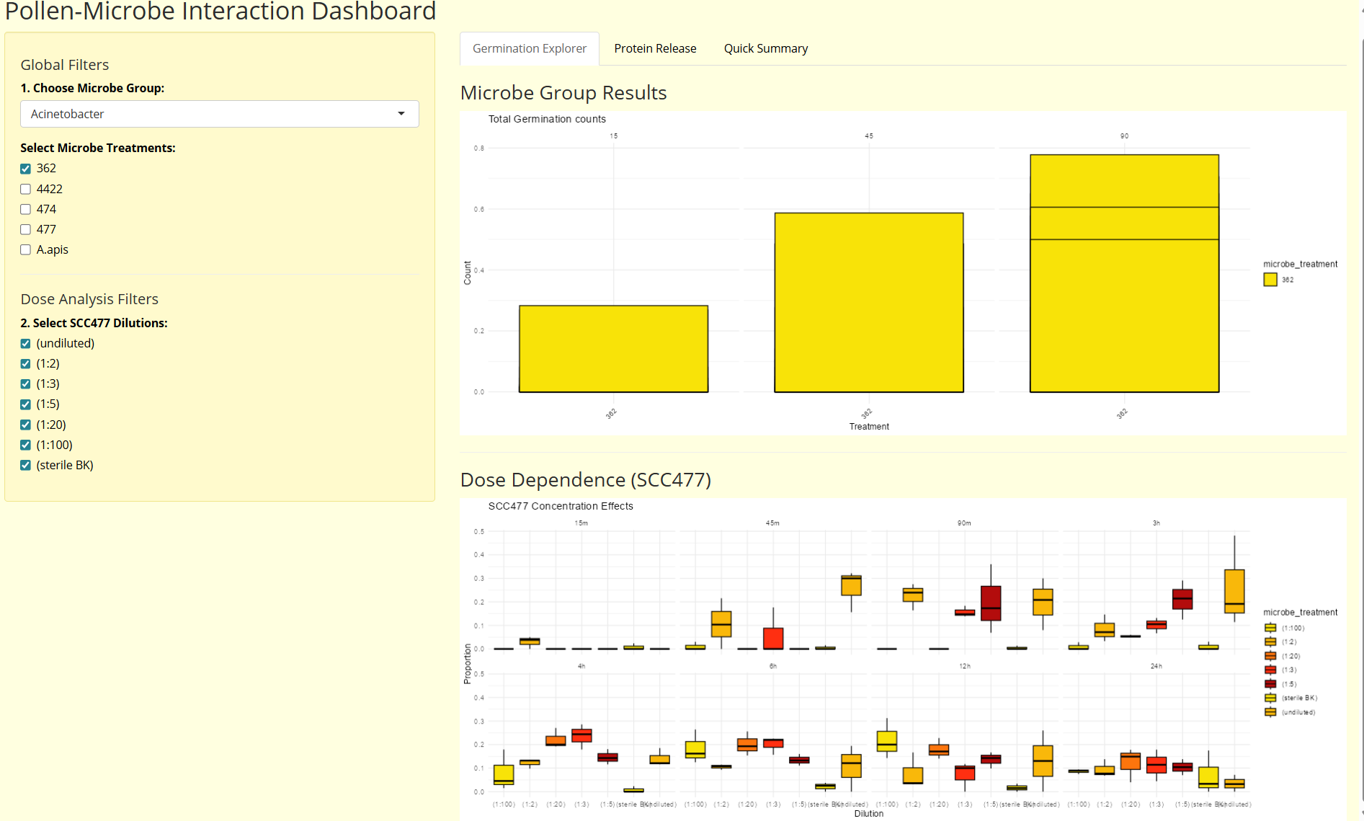
Shiny App
Notes:
nstead of just showing raw plots, use valueBox or infoBox (from the shinydashboard package) at the top of your app to show "Quick Stats" based on the user's current filters.
Top Performing Microbe: Automatically calculate which selected treatment has the highest allgerm count.
Average Burst Rate: Show a percentage of how much pollen is bursting vs. germinating in real-time.
Creative Touch: Use icons (like a seedling for germination or a "boom" icon for bursting) to make it visually engaging.
Since your data has multiple timepoints (15m, 45m, 3h, etc.), you can turn your static bar plots into an animation.
How: Add a sliderInput for time and use the gganimate package or simply let the user "play" through the hours.
Why: This allows the user to literally see the Acinetobacter inducing germination over time, making the transition much more impactful than looking at side-by-side facets.
Your data exploration shows that Acinetobacter induces germination while M. reukaufii (yeast) and other control degraders do not.
Creative Feature: Add a "Versus" mode where a user can select two specific treatments (e.g., A. pollinis vs. Control) and the app generates a specialized comparison plot with a text summary explaining the biological difference.
Contextual Tooltips: Use the plotly library so that when a user hovers over a bar, a popup shows the exact count and the specific "Microbe Group" description.

Slide 14
Conclusion + Next Steps
Bacteria (Acinetobacter) induced over
5X pollen germination & 20X pollen bursting
Acinetobacter grows to nearly twice the density compared to growth with ungerminable pollen
Prove researchers thought!!!!!
Notes:
From our data analysis and the paper
thanthat of uninoculated pollen by 45 min
. When provided with germinable pollen, A. pollinis stimulates protein release and grows to nearly twice the density compared to growth with ungerminable pollen
Proven researcher though
correlation between the two & stimulation of germination benefits bacterial fitness
Acinetobacter both specifically causes and benefits from inducing pollen germination and bursting.
Future work:
For researchers
Mechanisms behind induced germination
Potential of other flower-dwelling microbes alter pollen physiology to access nutrients
For us:
Data for related study

Slide 15
Thanks!

Slide 16
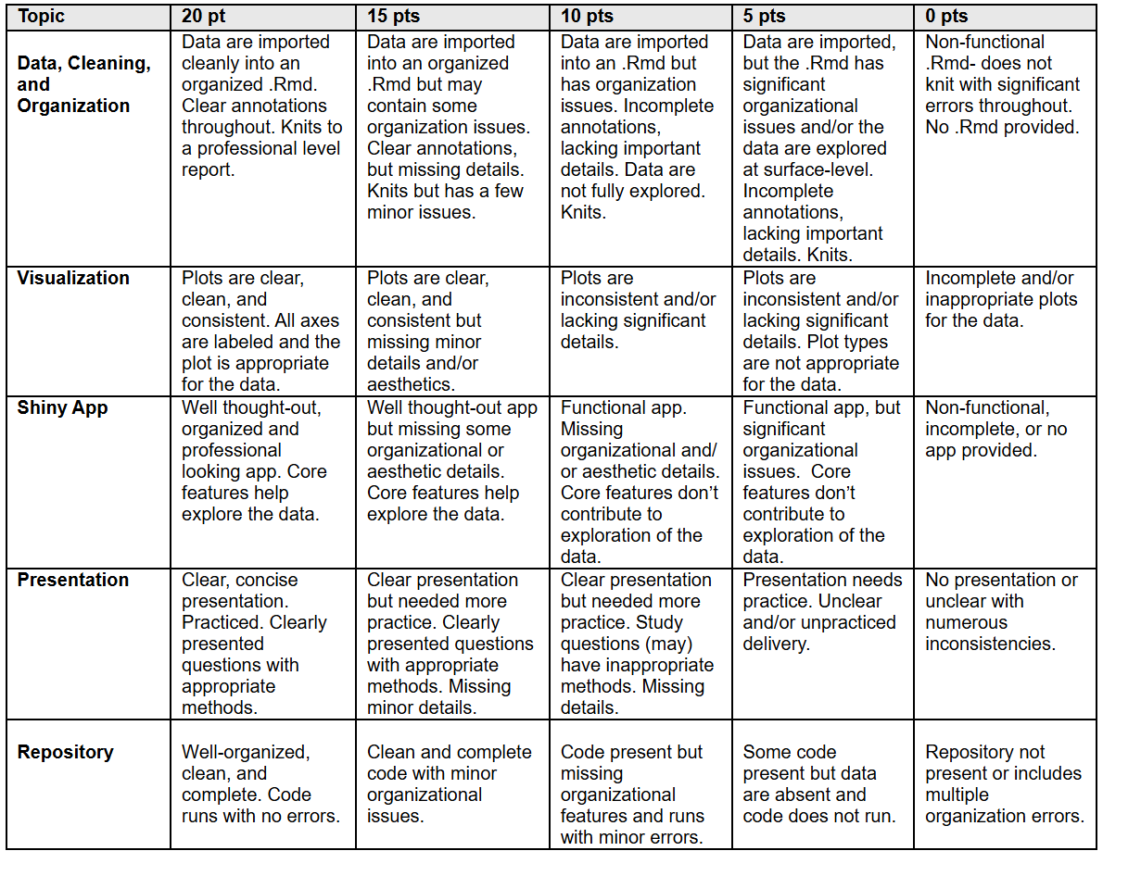
Rubric:

Slide 17
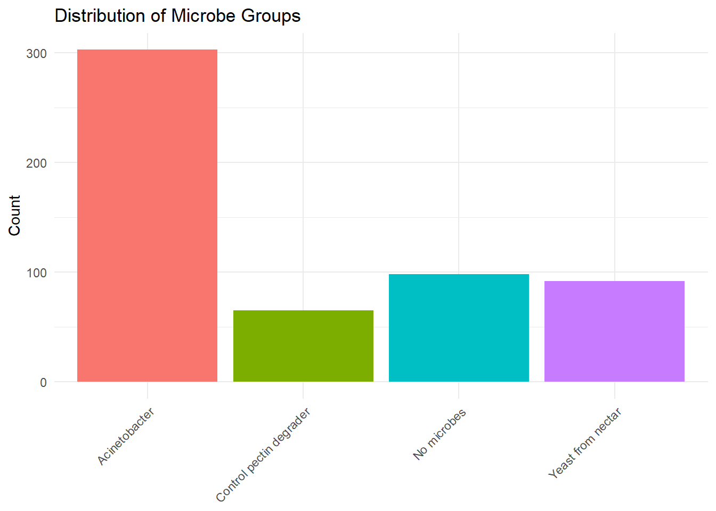

Slide 18
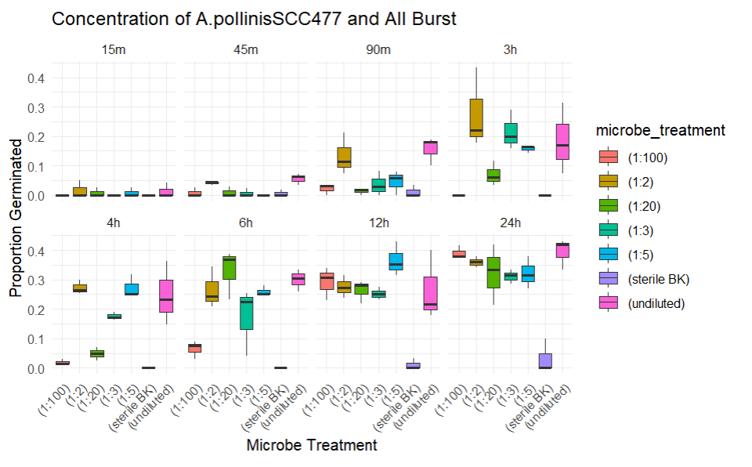
Notes:
- longer time –> more burst
- higher concentration —> more bursting
The proportion of pollen grains that expelled protoplasm into solution, including both "number.burst" and "number.tip.burst"

